Slide 1
Microns Influence on Onondaga Property Market
By Josephine Galdamez

Slide 2
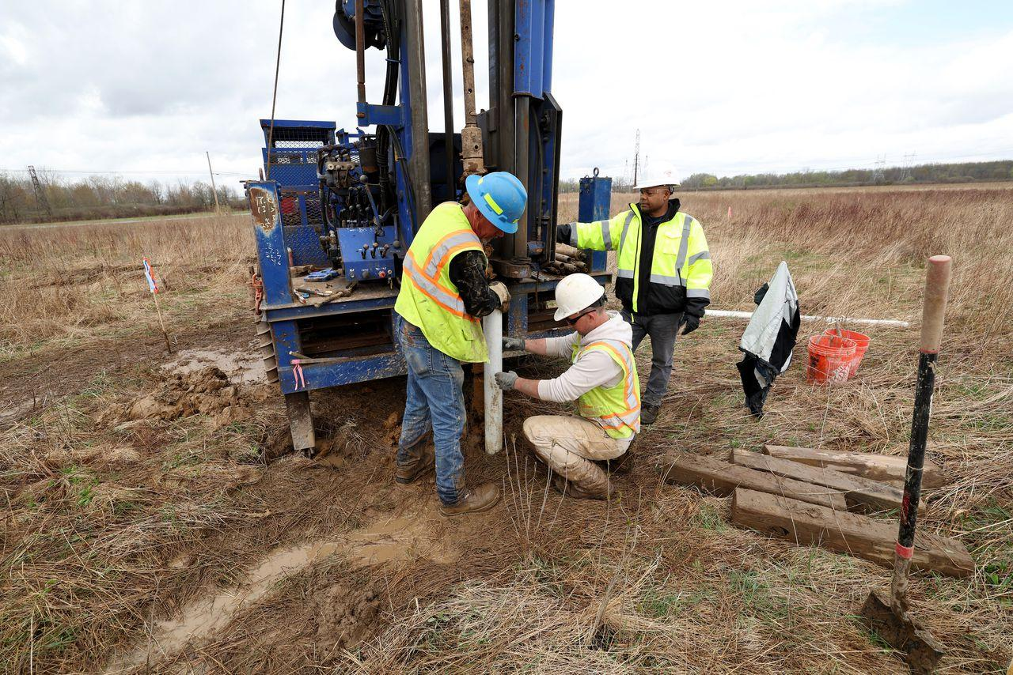
Background Info on Micron
Hypothesis- Have real estate prices gone up in Onondaga County since the announcement of Micron on October 2022?
Micron is a computer chip company planning to build in Clay, NY and spend as much as $100 billion over the next 20 years or more.
Possible Pros/Cons - enhanced equities or inequities?
Problems with research question- Micron has not been built yet, so it is difficult to identify its impact on the Real Estate market.

Slide 3
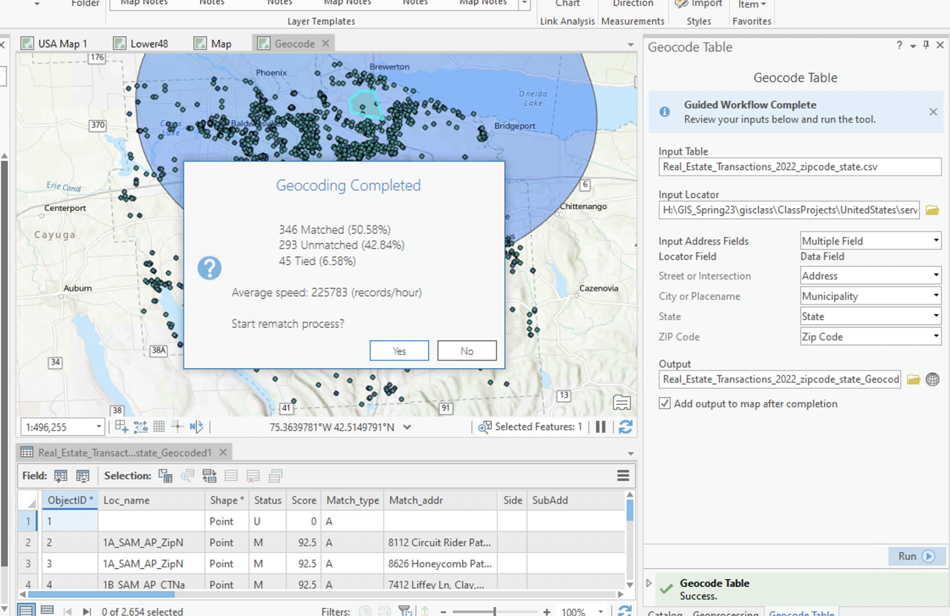
Methods
Geocoding- Python and ArcGIS
Residential Properties in Onondaga County. Looking at before and after the announcement of Micron .
Commuters - How much are they willing to commute to work?

Slide 4
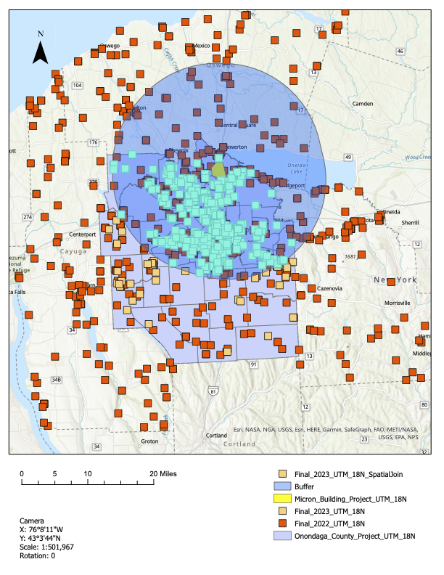
Methods
Buffer- 15 mile
Spatial Join
Census Tract
Digitize polygon for the location of Micron
Compare the 2022 data with 2022

Slide 5
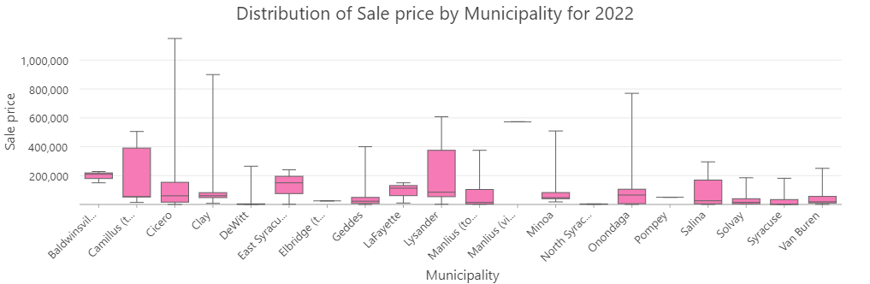

Slide 6
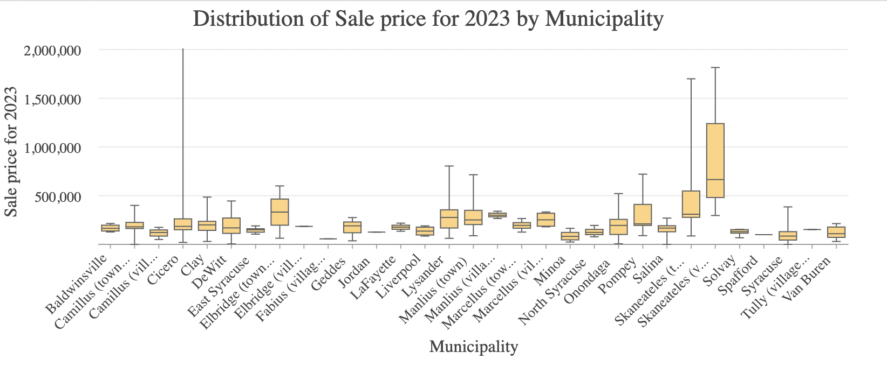

Slide 7
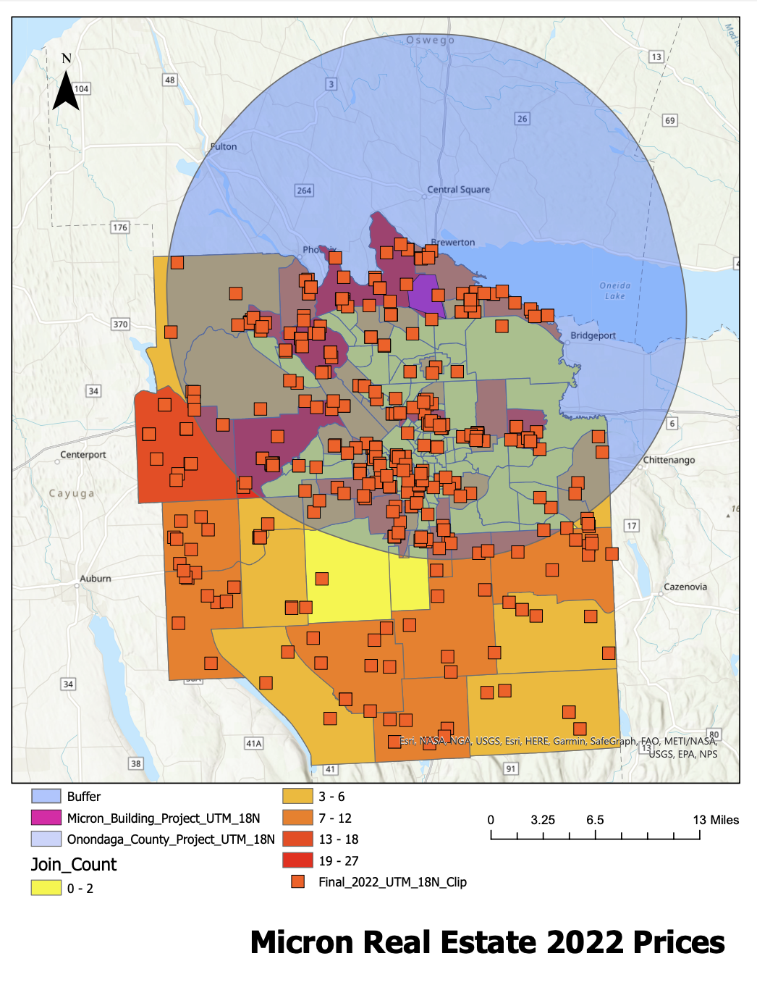
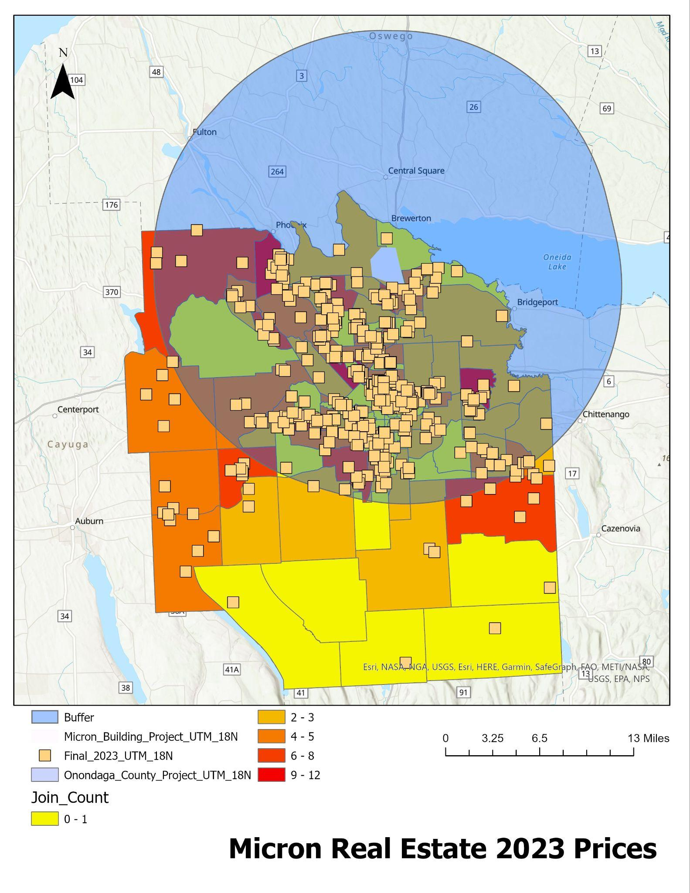

Slide 8
Key Findings
2022 has a ratio of 346/439 = 79%
2023 has a ratio of 406/443 = 91%
According to my findings, there are more residential houses being sold in Onondaga County and it is likely due to Micron.
While houses are being sold at a higher rate, how will this impact low income families specifically people of color from being able to afford homes in Syracuse?

Slide 9
Works Cited
https://www.syracuse.com/business/2022/10/micron-picks-syracuse-suburb-for-huge-computer-chip-plant-that-would-bring-up-to-9000-jobs.html
https://www.syracuse.com/realestate/transactions/
https://www.whitehouse.gov/briefing-room/statements-releases/2022/10/05/what-they-are-reading-in-the-states-syracuse-post-standard-biden-microns-computer-chip-deal-in-syracuse-area-another-win-for-america/

